Slide 1

EGB1201 – JAVA PROGRAMMING PROJECT REVIEW-2
Department of Electronics and Communication Engineering
Academic Year: 2025 – 2026 (Odd Semester)
Register Number Name
Year Semester Section Date
:927624BEC012
:AMARJEET KUMAR.V
:II
:III
:A
:20.11.2025
1
EGB1201 – JAVA PROGRAMMING –PROJECT REVIEW 2

Slide 2
Title of the Project
CITY NAVIGATION SYSTEM

Slide 3
Abstract
🞂​ A City Navigation System is designed to assist users in finding the most efficient routes within urban areas. Using GPS technology, real-time traffic data, and digital maps, the system provides accurate directions and travel times. It helps users avoid traffic congestion, locate important places such as hospitals, restaurants, and public transport stations, and plan their journeys effectively. The system improves urban mobility, saves time, and enhances the overall travel experience in the city.

Slide 4
Abstract with CO/PO Mapping
Abstract | CO | PO | PSO
A City Navigation System is designed to assist users in finding the most efficient routes within urban areas. Using GPS technology, real-time traffic data, and digital maps, the system provides accurate directions and travel times. It helps users avoid traffic congestion, locate important places such as hospitals, restaurants, and public transport stations, and plan their journeys effectively. The system improves urban mobility, saves time, and enhances the overall travel experience in the city. | CO1, CO2 CO3 CO4 CO5 | PO1, PO2, PO3, PO4, PO5, PO9, PO11, PO12 | PSO1, PSO2

Slide 5
Introduction
In today’s fast-paced urban life, navigating through crowded and complex city environments can be challenging. A City Navigation System is a digital solution that helps users find the most efficient routes to their destinations using GPS, real-time traffic data, and interactive maps. With the growing number of vehicles and increasing traffic, such systems have become essential for daily commuting, emergency services, tourism, and public transport planning.

Slide 6
Java Programming - Concepts Used
Database Connectivity
Integration with maps and GPS
Real-time traffic updates
Multithreading and performance
Backend development

Slide 7

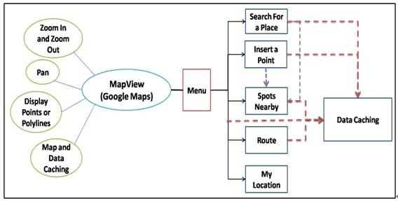
Proposed Architecture
CGB1201 – JAVA PROGRAMMING –PROJECT REVIEW 2

Slide 8
Proposed Architecture - Description
🞂​ This diagram represents the working of a Google Maps-based application (MapView) and its main features. The MapView allows users to zoom in and out, pan across the map, display points and use map data caching. Through the menu, users can access different functions such as searching for a place, inserting a point, finding nearby spots, getting routes, and checking their current location.Overall, the diagram shows how different map functions and menu options are linked together to provide an efficient and user-friendly mapping experience.

Slide 9
List of Modules
🞂​Location and GPS module
🞂​Map data management module
🞂​Route planning module
🞂​Navigation guidance module

Slide 10
Description of Modules
🞂​ Location & GPS Module:The location module is responsible for determining the user’s or device’s current position.
🞂​ Map Data Management Module: This module is responsible for storing, updating, and organizing map-related data.
🞂Route planning module:It uses map data, location information,
and sometimes real-time traffic updates.
🞂​ Navigation Guidance Module:This module is responsible for guiding the user step by step along the planned route.

Slide 11
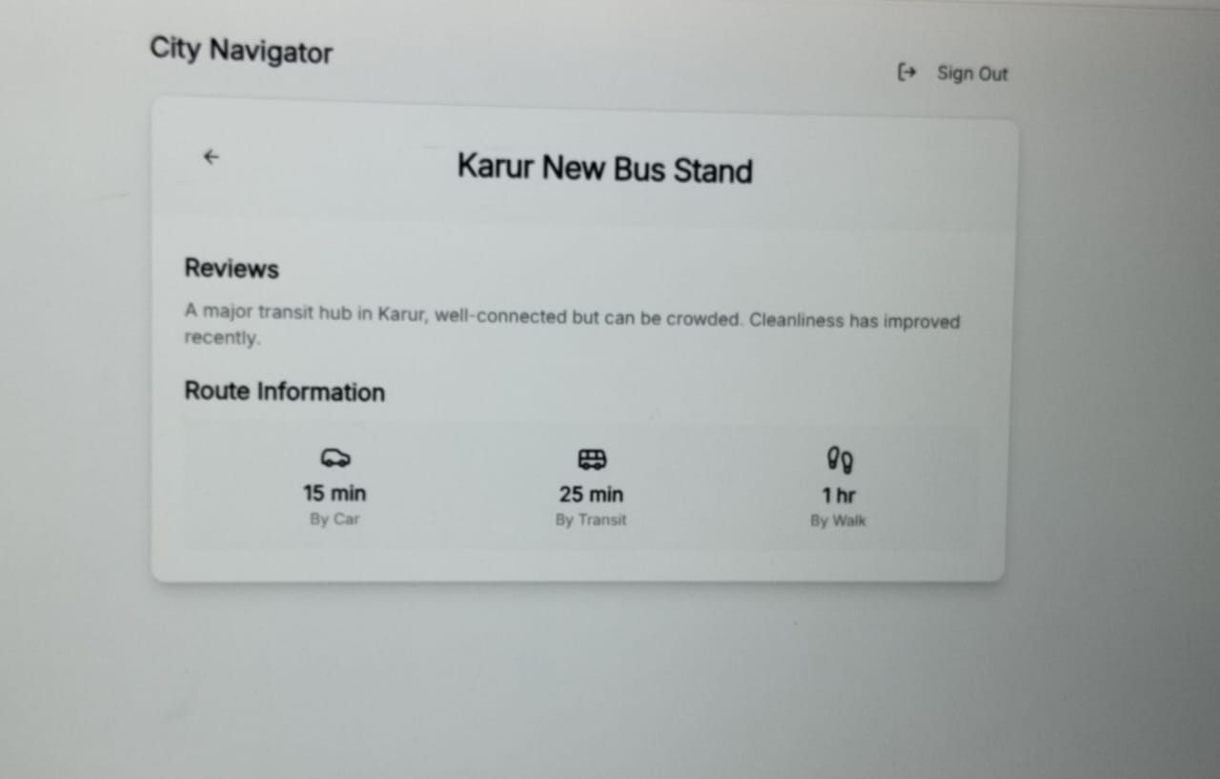
Result

Slide 12
CONCLUSION
CONCLUSION
The City Navigation System developed using Java successfully demonstrates how programming concepts can be applied to solve real-world navigation problems. This project helps users find routes, distances, and important locations within a city in an organized and efficient way.Through this project, we implemented core Java concepts such as object-oriented programming, data structures (like lists or maps), control statements, and exception handling. It improved our understanding of how navigation systems store city data, process user inputs, and generate meaningful outputs such as shortest paths and location details.

Slide 13
Reference
Zheng, Y., Capra, L., Wolfson, O., & Yang, H. (2014). Urban computing: concepts, methodologies, and applications. ACM Transactions on Intelligent Systems and Technology.
Quddus, M. A., Ochieng, W. Y., & Noland, R. B. (2007). Current map-matching algorithms for transport applications: State-of-the-art review. Transportation Research Part C.
Papinski, D., Scott, D. M., & Doherty, S. T. (2009). Exploring the route choice decision-making process using a multiobjective approach. Transportation Research Part F.7.

Slide 14
Thank You
ANY QUERIES???

